Slide 1
Equity, Diversity, & Inclusion in Science Micro-Lessons
Impostor Syndrome in (Your Discipline)
Notes:
Click to reveal 4-minute YouTube video

Slide 2
Poll Everywhere Question:
What are some things a person can do to challenge impostor syndrome?
Ways to Overcome Impostor Syndrome:
Share how you feel with others
Separate feelings from fact
Recognize when you should feel fraudulent
Accentuate the positive
Develop a new response to failure & mistake making
Right the rules
Develop a new script
Visualize success
Reward yourself
Fake it until you make it
Notes:
Open ended question – have class use cell phones to text (put number on screen)
Ways to overcome impostor syndrome:
Break the silence: share how you feel with others
Separate feelings from fact: You *have* feelings, which does not mean that you *are* this feeling. A feeling does not mean it’s true.
Recognize when you should feel fraudulent: If you’re a new employee or if you are in a new university course, you should feel doubt! It’s normal
Accentuate the Positive: students are often hard on themselves for mistakes: Forgive yourself! You CANNOT be perfect if you are learning something new!
Develop a new response to failure and mistake making: Learn from your mistakes and keep moving forward!
Right the Rules: You have just as much right as everyone else to make mistakes or ask questions (no one expects you to somehow know everything!)
Develop a new script: Your script is that automatic mental tape that starts playing in situations that trigger your impostor feelings. When you start a new class or project, think something posiive like: ‘I won’t know all of the answers, but I know I can figure them out or ask for help! I know I can learn.’
Visualize success: Picture yourself successfully making a presentation or asking a question. Try not to focus so much on what could go wrong.
Reward yourself: celebrate your achievements. Did you pass a quiz? Great! Treat yourself!
Fake it till you make it: Now and then, we all have to fly by the seat of our pants, and courage comes from taking risks. Don’t wait until you feel confident to put yourself out there, or you may never do so. If you have a question, try asking it in class, or emailing the prof or a TA– it’s intimidating, but you can do it!
(source: https://www.concordia.edu/blog/impostor-syndrome-a-college-student-nightmare.html)

Slide 3
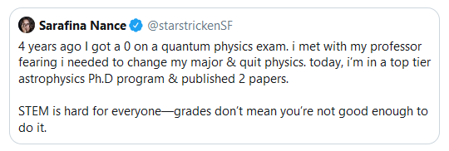
Impostor Syndrome
A Personal Fail Forward Moment:
Notes:
Place in a few examples from own discipline to inspire and encourage students, reminding them that everyone fails (it’s part of learning)
Google for fail forward posts. Example of article featuring posts for physics: https://www.khaleejtimes.com/international/americas/google-ceo-applauds-student-who-scored-zero-in-physics-exams
Can share personal story here of a time you failed and how you felt, as well as how it contributed to your success
Optional: Can post this 3 minute self test on brightspace and encourage students to take the test: https://www.idrlabs.com/3-minute-impostor-syndrome/test.php

